Slide 1

Why this module?
With the advent of high-end processing, computers with lower memory and processing power have became obsolete. Application performance did not improve substantially even with upgraded hardware. As a result, code tuning became a successful approach to get the best performance from applications.
Code tuning involves optimizing the use of available resources on the target platform and the source code or the algorithm. It involves using Profilers to analyze the code and performance analyzers/monitors to analyze the resource usage.
This module deals with identifying the factors and areas that affect the application performance. It deals with how to use the tool to improve the application performance.

Slide 2
Objectives
In this session, you will learn to:
  Identify the need for application optimization
  Identify the application optimization process
Notes:
Ask the students, what they expect from the session.
Explain the objectives of the session.

Slide 3
Exploring Application Optimization
The performance of an application depends on the:
  Source code
  Algorithm
  Compiler
  Computer architecture
Application optimization is the process of obtaining the best performance from an application on a given hardware and network specification.
The performance of an application can be improved by making effective use of the available resources.
Notes:
Ask the students, what they expect from the session.
Explain the objectives of the session.

Slide 4
Exploring Application Optimization (Contd.)
Application optimization:
  Improves application performance
  Leads to a better response time
  Enables effective utilization of system resources
The following application areas require optimization significantly:
  Client/Server applications
  Database-dependent applications
  Scientific applications
  Threaded applications
Notes:
Ask the students, what they expect from the session.
Explain the objectives of the session.

Slide 5
Exploring Application Optimization (Contd.)
Client/Server applications:
  Tend to be slow because various factors affect performance, such as speed of execution at the client and server sides and the speed of the connection.
  Optimization options requires the following points to be taken into account:
    Identify the areas that decrease performance
    Identify alternatives to optimize performance
Notes:
Ask them to identify the reasons for slowing down of the client/server applications and how they can speed up the execution of the application.

Slide 6
Exploring Application Optimization (Contd.)
Database-dependent applications:
  Are slow because database transactions take a substantial amount of time
  Takes a long time in searching and sorting records due to large size of databases
  Optimization options requires the following points to be taken into account:
    The number of triggers fired with each transaction that occurs
    The number of access to the database from the application
    The number of records that the application fetches at a time for processing
Notes:
In this slide, the faculty can give the example of database-dependant applications.
Ask the student the meaning of triggers.

Slide 7
Exploring Application Optimization (Contd.)
Scientific applications:
  Are used in real-time systems, such as weather forecasting, aircraft engine automation, and radio electric power generation
  Are mostly mission critical and involve many complex calculations
  Optimization options requires the following points to be taken into account:
    Algorithm design
    Compiler
    Operating system
    Processor architecture

Slide 8
Exploring Application Optimization (Contd.)
Threaded applications:
  Can be used for lengthy processing and memory reads and writes
  Can be optimized by deciding the optimal number of threads that are created for an application
    The number of threads created also depends on the ability of the processor and the operating system to handle multiple threads
Notes:
In this slide, ask the student the meaning of a thread. Tell the students that threads enables you to increase the performance of your application to a great extend.

Slide 9
Exploring Application Optimization (Contd.)
The performance of an application depends on computer architecture, application design, and system resources.
As a result, you should analyze application performance at three levels:
  System level
  Application level
  Microarchitecture level
►
  Highest level of optimization
►
  Middle level of optimization
►
  Lowest level of optimization
Notes:
Ask the students to identify the different levels at which you can optimize the performance of an application.
Ask students what is complier optimization?
Compiler optimization techniques are optimization techniques that have been programmed into a compiler. These techniques are automatically applied by the compiler whenever they are appropriate.
Explain that compiler optimization is application level tuning.
Compiler optimization techniques are optimization techniques that have been programmed into a compiler. These techniques are automatically applied by the compiler whenever they are appropriate.
For example, you can tune the compiler for performing database read and write operations.

Slide 10
Exploring Application Optimization (Contd.)
Optimization Level | Optimization Goals | Focus Areas | Performance Improvement Level
System Level | Improving application interaction with the system | Network problems Disk performance Memory usage | Three times improvement
Application Level | Improving algorithms | Data structures Function-calling sequence Threading algorithm | Two times improvement
Microarchitecture Level | Improving application interaction with the processor | Data availability in cache Code availability in cache Data alignment | 1.1-1.5 times improvement
Notes:
System level of optimization involves tuning the application with respect to system level DLLs and APIs.
Optimizing performance at application level involves predicting the run-time of applications, improving algorithms, using performance libraries and implementing threading.
Computer architecture level of tuning is used for specific applications. For example, if a large banking corporation uses only database applications, the processor that they use must be fast enough to support some minimum number of transactions. In this case, the micro architecture of the processor can be tuned so that it performs database transaction very fast. Though, some other capabilities of the processor might be reduced.
FAQ(Data alignment)- Alignment refers to the property of memory address. It is expressed as the numeric address modulo power of two. CPU executes the instructions that operate on the data, which is stored in the memory.

Slide 11
Just a minute
What are threaded applications?
The performance of an application depends upon what all factors?
Answer:
  An application designed to take full advantage of the processor by using multiple threads is called threaded application.
  The performance of an application depends on computer architecture, application design, and system resources.

Slide 12
Identifying the Application Optimization Process
During optimization, you need to:
  Identify optimization goals
  Follow the appropriate optimization method
  Stop the process when the desired level of optimization is achieved
Notes:
Ask the students the series of steps to optimize application performance
Explain to the students that the method of optimization which you will follow depends on optimizing goals.
Explain that identifying the optimizing goals and the appropriate optimization method is necessary to get best output in shortest amount of time.

Slide 13
Identifying the Application Optimization Process (Contd.)
The performance optimization process is an iterative cycle, which consists of the following phases:
  Gather performance data
  Analyze data and identify performance issues
  Generate alternatives to resolve issues
  Implement enhancements
  Test enhancements
Notes:
Explain the Application Optimization Cycle.

Slide 14
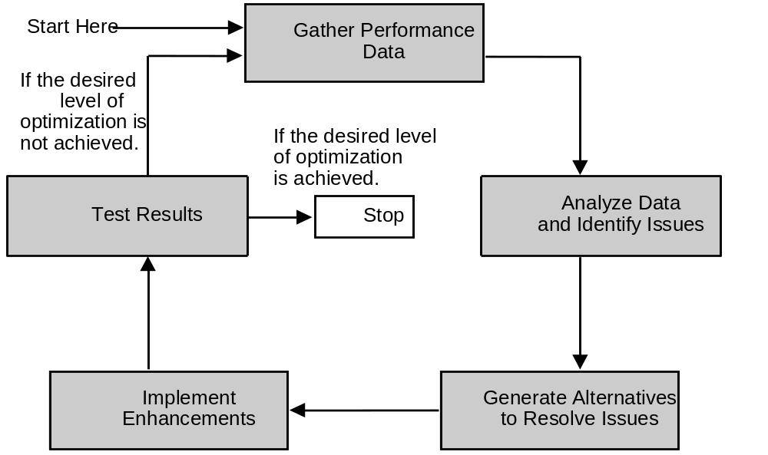
Identifying the Application Optimization Process (Contd.)
Notes:
Explain to the students that the optimization process is an iterative process, consists of five steps, and that you need to reiterate through the cycle until the desired level of optimization is achieved.

Slide 15
Identifying the Application Optimization Process (Contd.)
Gather performance-related data for:
  Processor utilization
  Memory utilization
  Time taken for execution
To gather performance-related data, you can:
  Use timing functions to calculate execution time
  Use stop watch to measure execution time
  Use performance analysis tool
Notes:
Ask the students the need to collect performance data.
Explain that you need to collect performance data based on the focus area, such as processor utilization, memory utilization, or execution time.
Also explain the various ways to collect performance data.

Slide 16
Identifying the Application Optimization Process (Contd.)
Analyze performance-related data to identify:
  Hotspots
  Bottlenecks
Bottlenecks can be:
  Memory operations
  Memory alignment
  Floating point operations
  System calls
►
  Input/output (I/O) operations access memory to read or write data.
  As a result, the speed of I/O operations is limited by the speed of memory.
►
  The time required to access the data depends on how the objects and variables reside in the memory. This is called memory alignment.
►
  Floating-point operations consume both space and time.
  They increase the time and space complexity.
►
  System calls include input/output operations to disks, devices, and operating systems.
  During the non availability of the resources, processor might have to wait, which further leads to bottlenecks.
Notes:
Explain that you need to identify the areas that are taking more time to execute and also the resources or bottlenecks that are causing the application to run slowly.
Ask the students to identify the common bottlenecks that can cause the computing process to slow down.
Explain the common bottlenecks, such as speed of I/O operations limited by the speed of memory, improper data alignment in the memory leading to delay in accessing data
Floating point operations in a program might be a bottleneck as it leads to increase in time and space complexity.
Also explain the general analysis strategy to analyze the performance, such as identifying the routines and data structures that take up major portion of application time

Slide 17
Identifying the Application Optimization Process (Contd.)
Alternatives to resolve issues can be:
  Optimizing memory operations
  Optimizing floating point operations
  Optimizing system calls
►
►
►
  Accessing memory locations that are located at a distance from each other will require more processor time and might retard performance.
  Therefore, write code that access memory sequentially.
  The total number of floating-point operations must be reduced as much as possible.
  Data must be loaded in the memory before executing instructions, so that the process need not wait for data.
  Optimizing a floating-point operation might significantly improve the program if it is used many times in the application.
  If you need only a small part of a service that the operating system offers, you can build custom routines.
  This is more efficient than loading the larger routines that the operating system provides.
Notes:
Explain the various alternatives that can be used to resolve performance issues. For example: if a data structure too large to fit in the memory is retarding the application performance then you can use smaller data structures to increase memory.
Explain that memory operations can be optimized by writing codes that accesses memory sequentially.
Ask the student, why sequential access of memory is more efficient?
(FAQ Global data structure)

Slide 18
Identifying the Application Optimization Process (Contd.)
Implement enhancements by:
  Splitting bulky loops
  Using optimal data structures
  Minimizing the use of global data structures
  Simplifying branches
  Placing the most likely branch first
  Placing decision making constructs outside the loops
Notes:
Ask the students the various ways to implement the enhancement in an application to optimize performance.

Slide 19
Identifying the Application Optimization Process (Contd.)
Test enhancements to ensure that:
  The results the optimized version computed are correct
  The performance of the optimized version meets the desired level
Notes:
Ask the students the need to test the enhancements implemented.

Slide 20
Just a minute
What do you mean by hotspot?
Answer:
  After collecting performance-related data, the data needs to be analyzed. This analysis is the process of identifying areas that take more time to execute. These areas are called hotspots.

Slide 21
Identifying the Tools for Performance Optimization
Various optimizing tools help in analyzing the:
  Application code usage
  System level resource usage by the application
Commonly used tools are:
  Perfmon
  JProfiler
  VTune
Notes:
Ask the students to name few tools that you can use to optimize application performance
Ask what does these tools analyze which help in optimizing application performance?

Slide 22
Identifying the Tools for Performance Optimization (Contd.)
Perfmon:
  Used in Windows operating systems, such as Windows XP
  Enables you to view the system level resource usage
JProfiler:
  Is a Java profiler
  Enables you to view performance bottlenecks, memory leaks and provides data related to the threading issues.
VTune:
  Is a tool by Intel
  Enables you to find the system resource utilization and execution time taken by various modules or functions
Notes:
Explain that the performance analysis tools provide maximum support for low level languages
Explain the features of various tools and how these tools help in optimizing application performance.

Slide 23
Summary
In this session, you learned that:
  Application optimization is the process of obtaining the best performance from an application within the constraints of a given set of hardware and network resources.
  Applications that require performance optimization are: client/server, database-dependent, scientific, and threaded applications.
  Application performance tuning can be performed at the system, application, and microarchitecture levels.
  Common performance issues include input/output operations, floating-point operations, and system calls.
Notes:
Summarize the session.

Slide 24
Summary (Contd.)
  The performance optimization process consists of the following five steps:
    Gather performance data
    Analyze data and identify issues
    Generate alternatives to resolve issues
    Implement enhancements
    Test enhancements
  Some of the commonly used tools and utilities to optimize application performance are as follows:
    Perfmon
    JProfiler
    VTune
Notes:
Summarize the session.

